Slide 1
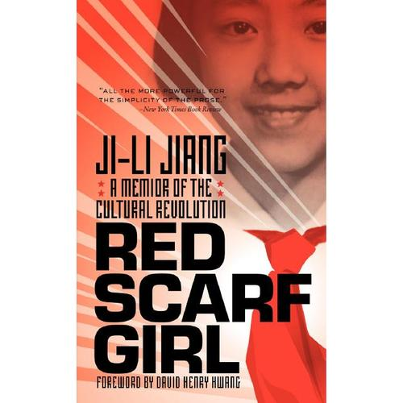
Red Scarf Girl
A Cultural Revolution

Slide 2
Red Scarf Girl Characters
Jiang-Ji-ling
Ji-Yun
Ji-Yong
Song-po-po
Grandma Cao
Mom
Dad

Slide 3
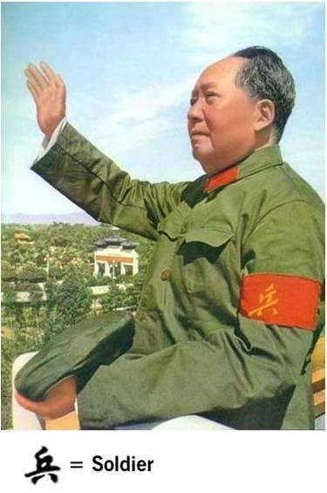
Exposition and Rising Action
The story takes place in Shanghai, China, during the onset of Chairman Mao Ze-dong's Cultural Revolution.
Jiang Ji Ling gets asked by the Liberation Army soldier to audition.
Writing da-zi-bao was a rising action.

Slide 4
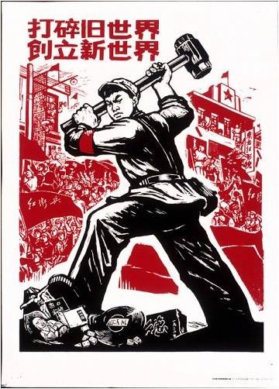
Climax
The climax of the book occurs when Ji-Li is forced to make a tough decision. Her father is being detained for crimes which Ji-Li believes he did not commit. However, the accusers will not accept this for an answer. If she refuses to tell them what they want to hear, she will be forced to suffer for the rest of her life. She will be marked as a counterrevolutionary and all privileges will be taken from her. However, if she accuses her father, she will be invited to join the political elite. Ji-Li is involved in a Man-vs.-Self conflict.

Slide 5
To Find Out The Rest Read
Red Scarf Girl

